Slide 1
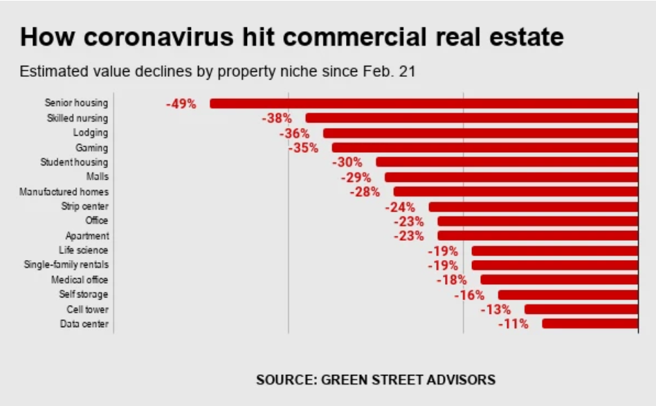
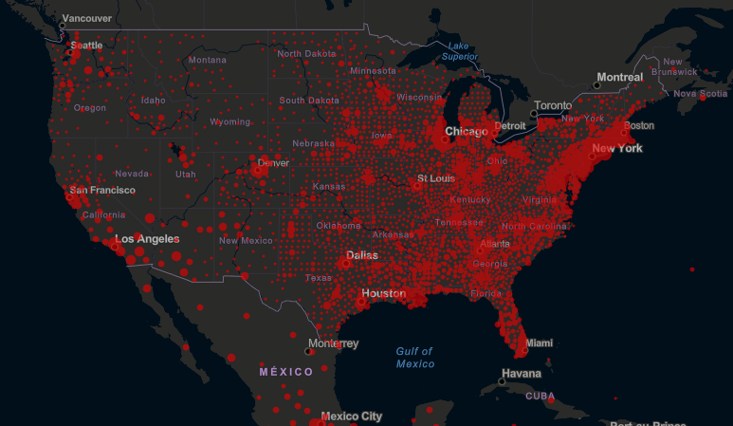
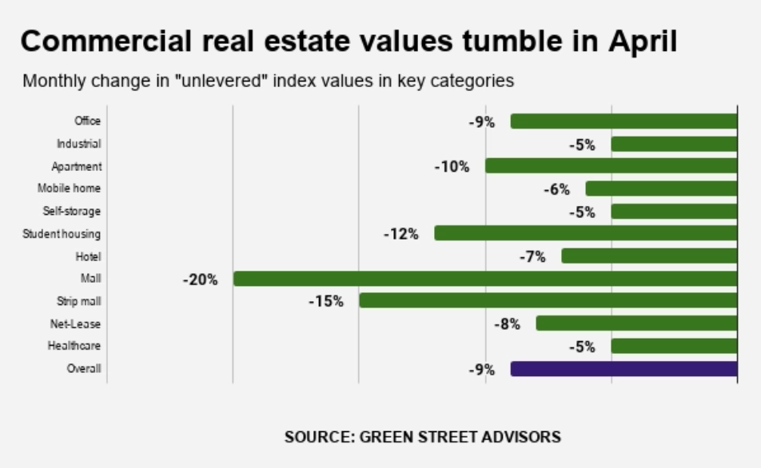
REAL ESTATE AND COVID-19
“Coronavirus puts real estate ‘on brink of collapse
If not immediately addressed, this cycle cascades into chaos”
Tom Barrack
Founder and Executive chairman of REIT Colony Capital Inc.

Slide 2
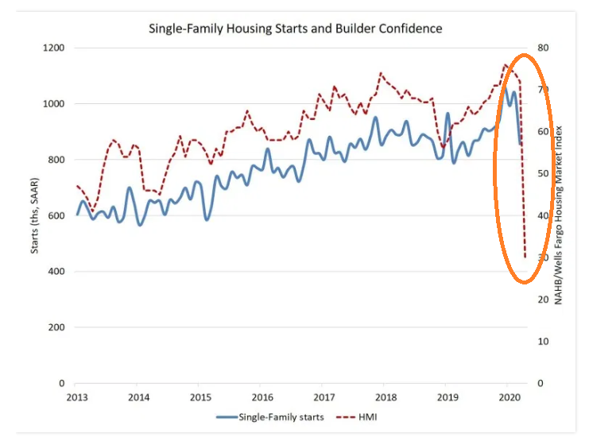
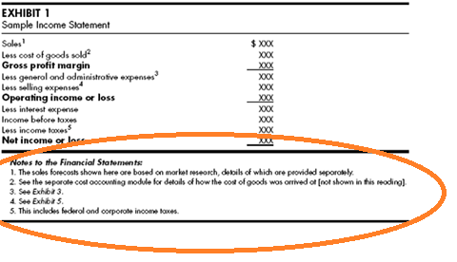
REAL ESTATE AND COVID-19
New builds (starts) of residential homes have
decreased 10% MoM and 18% YoY primarily due to
COVID-19 restrictions
Question of interest:
What are the longer-tail ramifications of this on housing inventory,
the real-estate sector, and new-home buyers? How might this impact
future investment decision making?
Additional impacts due to COVID-19 may be tucked away
within financial statement footnotes.
Question of interest:
Can we mine these footnotes for select organizations to pull additional
and preferably, actionable insight into our model mentioned above?

